Slide 1
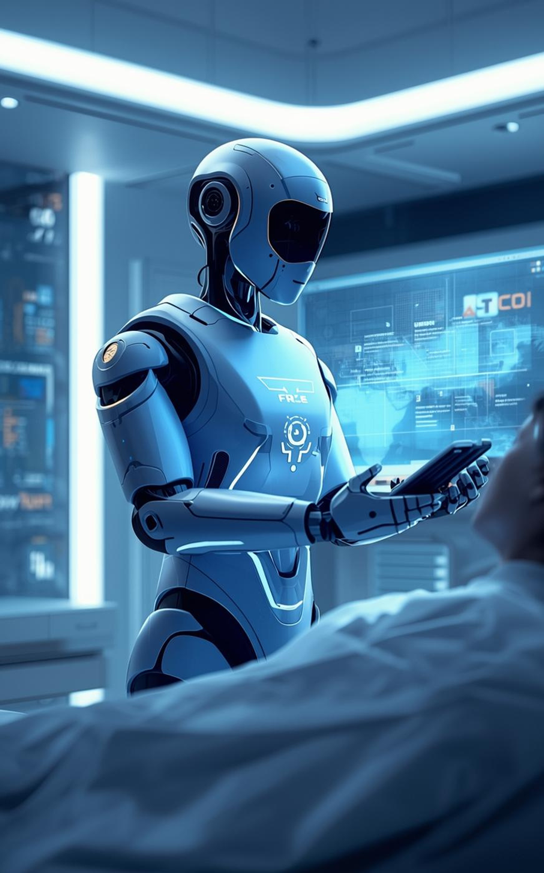
Team 4 R.A.D.A.R. Remote Autonomous Doctor Assistance Robot —Bridging Distance in Healthcare
Prepared by
Salma Ismail Bilal Fayad Yusuf Guenena

Slide 2
Contents
Problem Definition
Hardware Design/ Connections
Software Design
Integration
GUI Interface
Results
Testing And Validation
Future Work
Questions

Slide 3
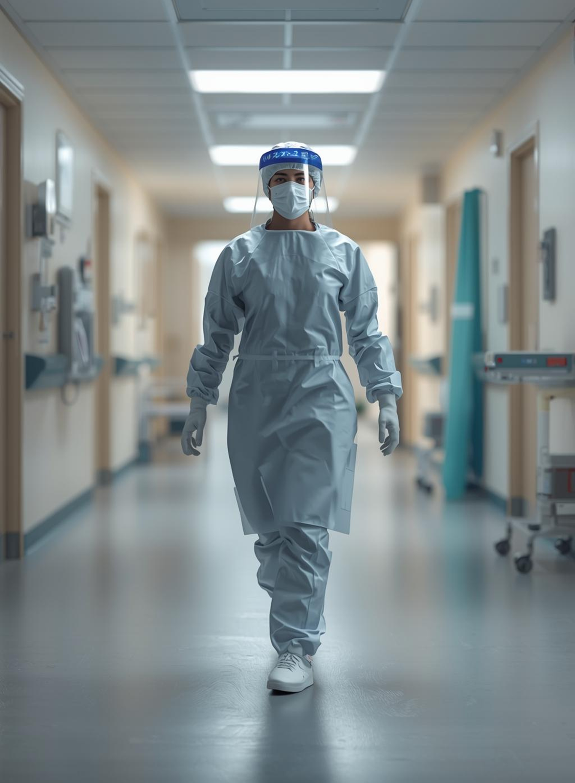
The Problem
Modern healthcare faces significant challenges including:
High infection exposure
Wasted clinician time
Limited remote monitoring solutions
Tanzania — 1 Oncologist for 45 Million People
Meara et al., The Lancet Global Surgery 2030, 2015

Slide 4
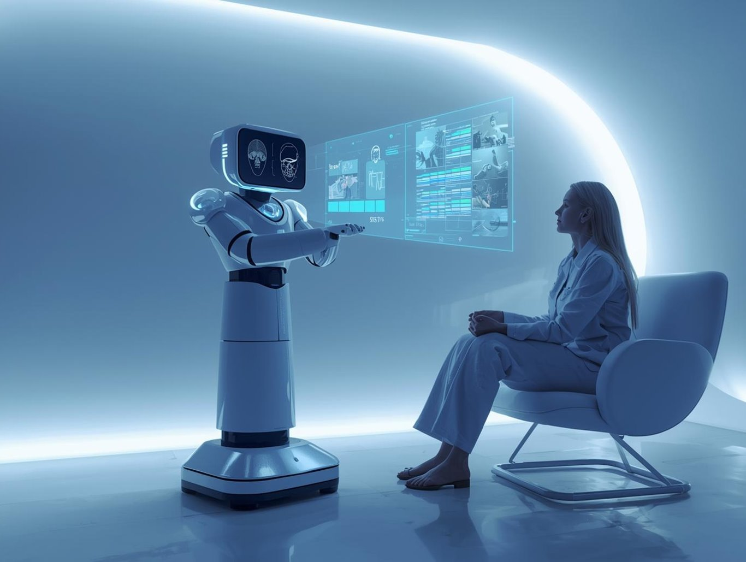
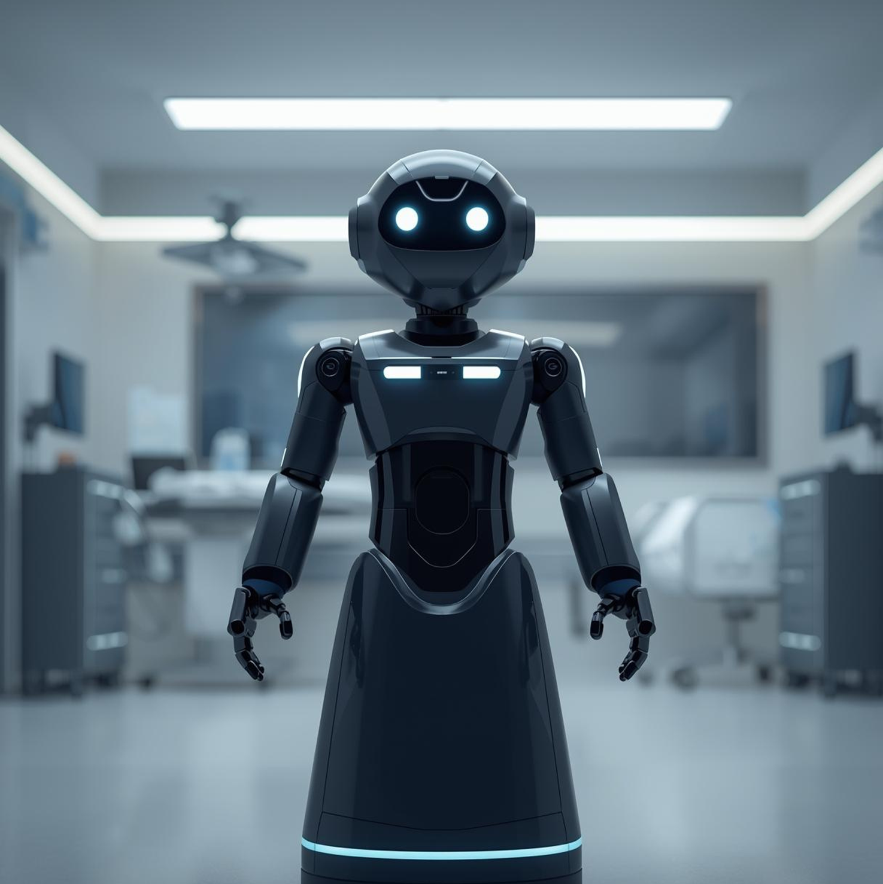
Our Solution
Proposed Solution:
Full telepresence robot
Two-way audio + video
Motorized tray delivery
Radar-based navigation
Completed Prototype:
Live camera feed
Pan–tilt camera mechanism (3D printed)
Real-time pulse oximeter vitals
ROS2 communication to GUI

Slide 5
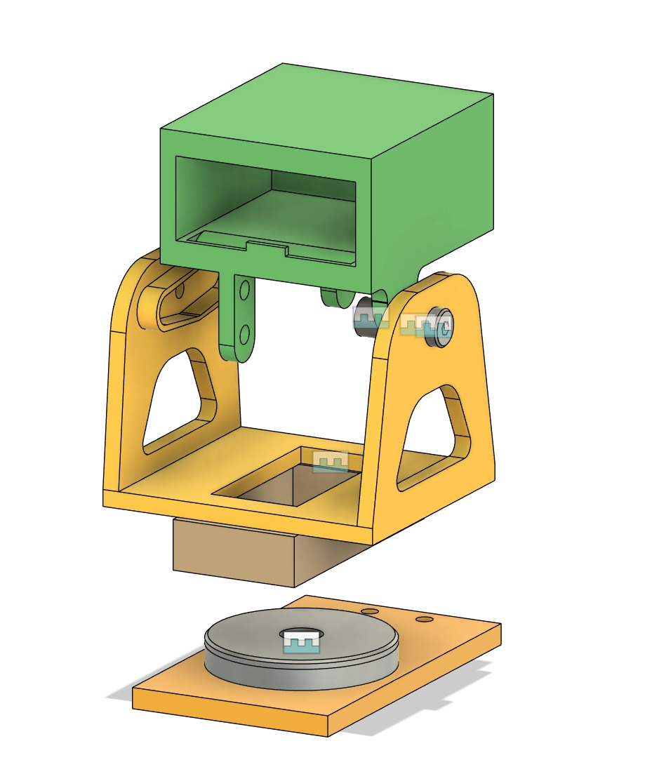
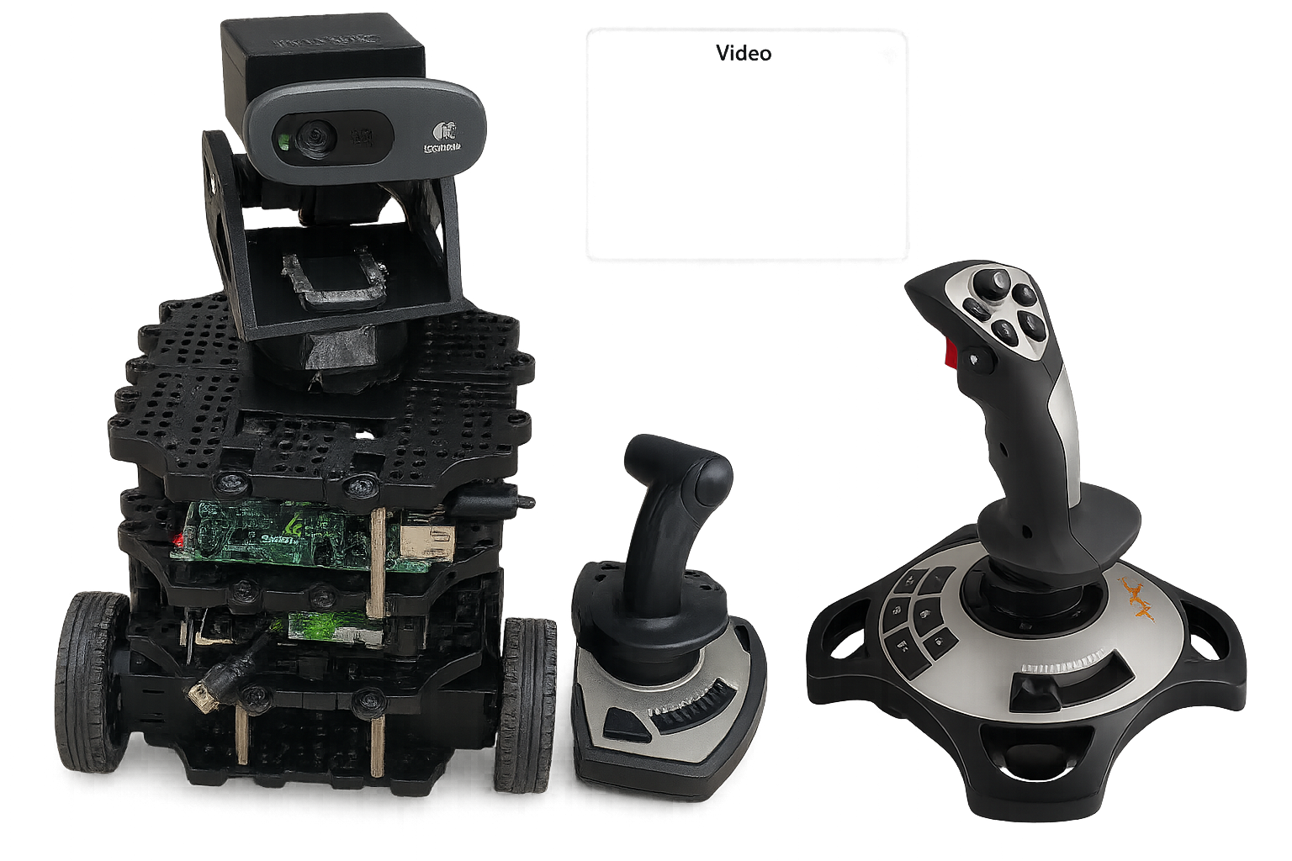
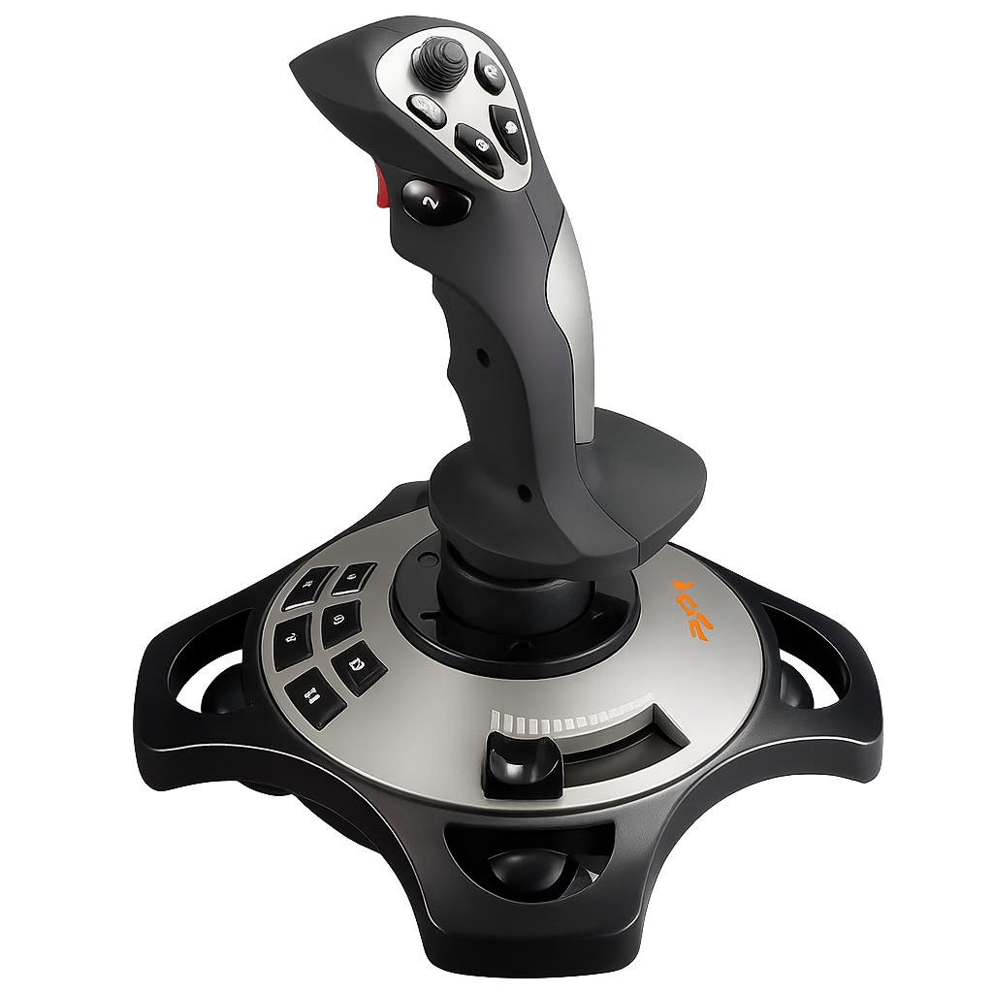
Hardware Design
Pan-tilt Mechanism
Custom 3D-printed pan–tilt assembly
Bottom servo = pan, top servo = tilt
Camera mounted on printed bracket
Raspberry pi 5V supply for servo movement
Controlled using a joystick

Slide 6
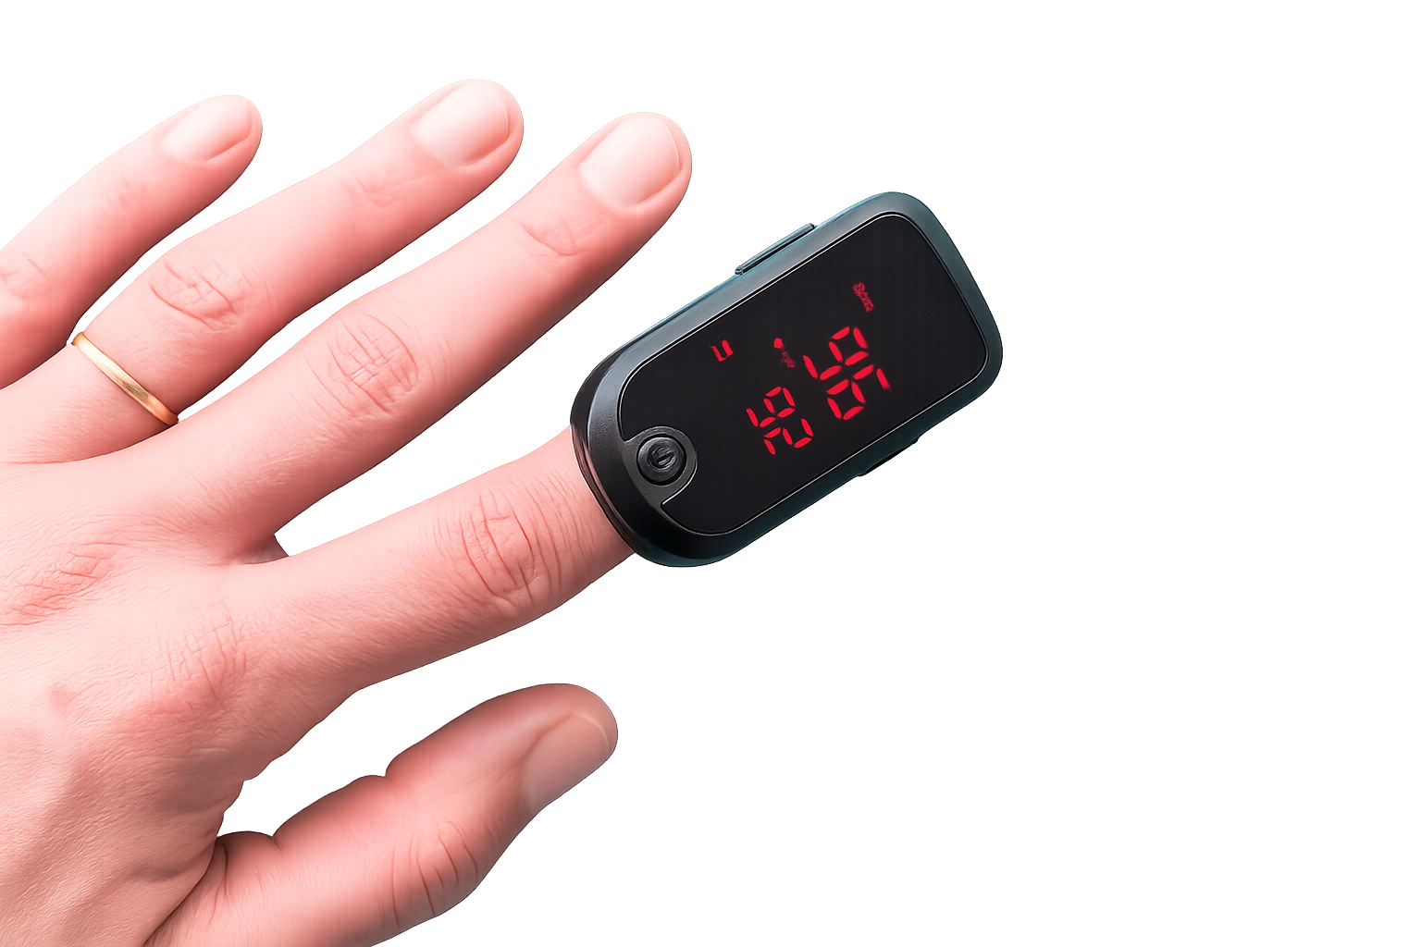
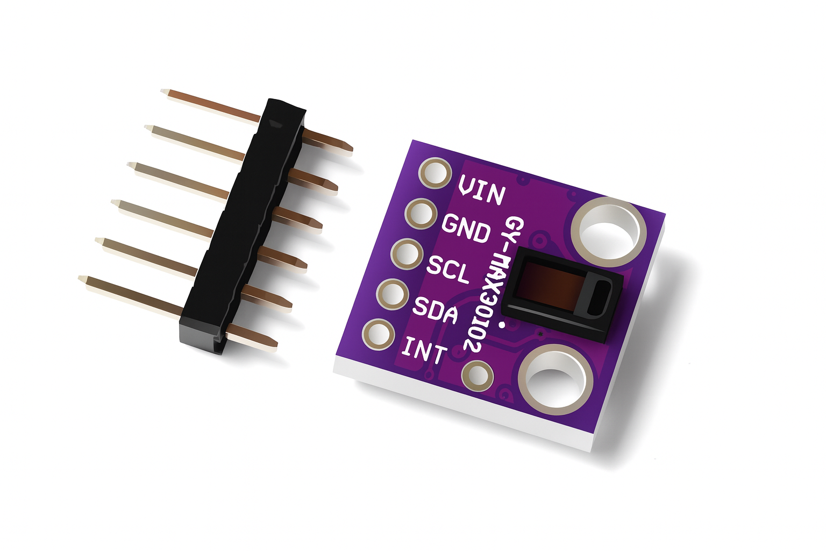
Hardware Design
Pulse Oximeter
MAX30102 sensor for HR & SpO₂
I²C communication to main controller
ROS2 publishes vitals to GUI in real time
(publishes to /pulseox_vitals)
Adds live clinical monitoring capability

Slide 7
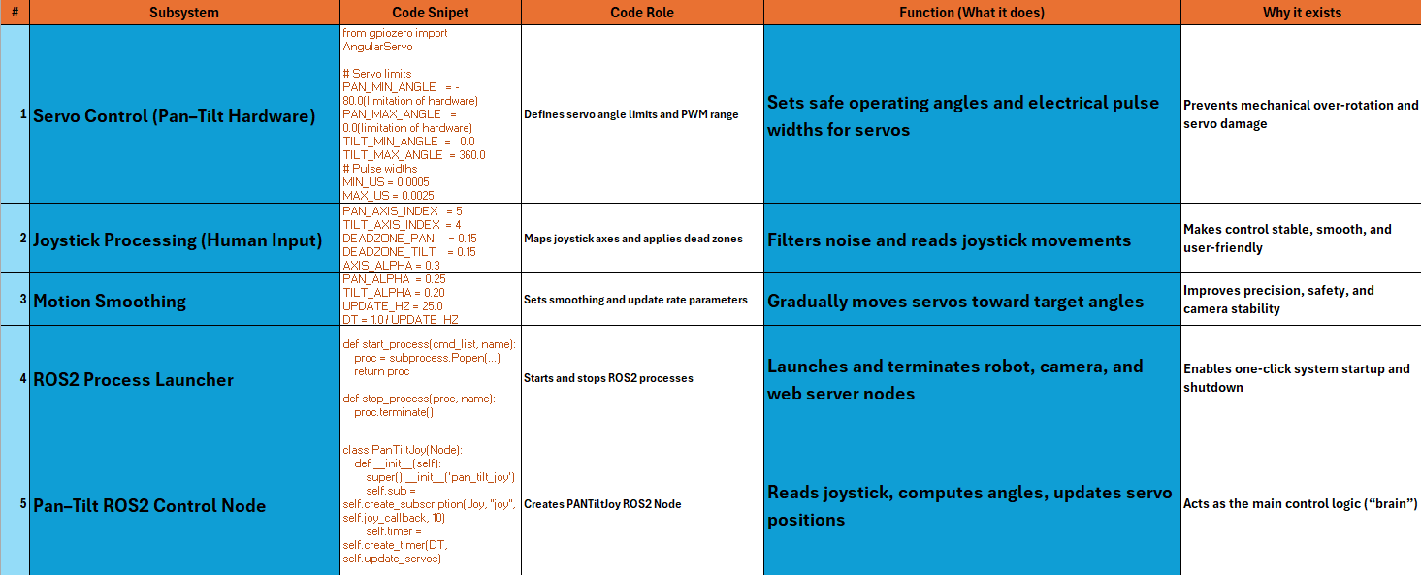
Software Design(Rasberry Pi)

Slide 8
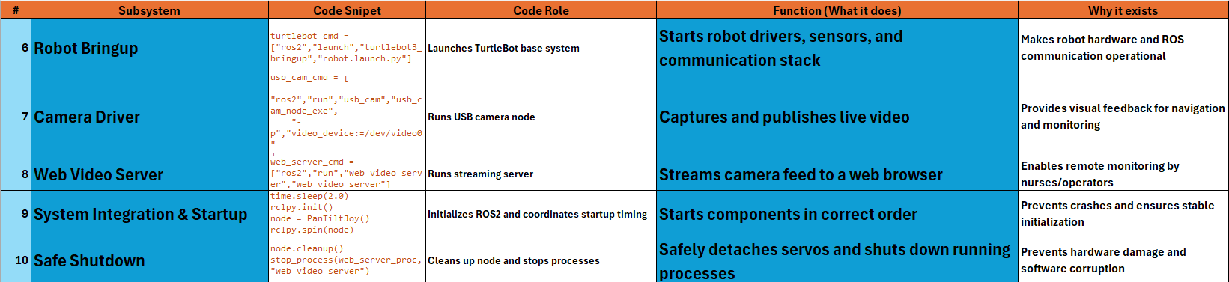
Software Design(Rasberry Pi)

Slide 9
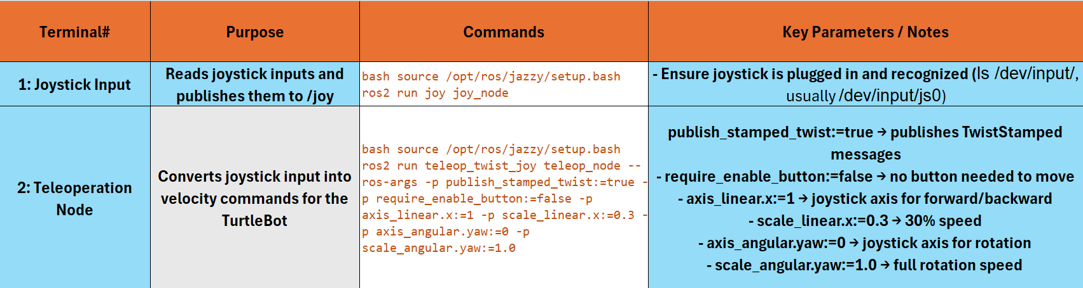
Software Design(Remote PC)

Slide 10
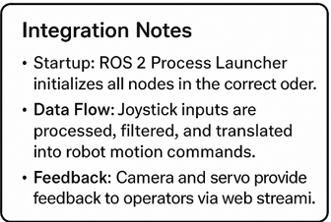
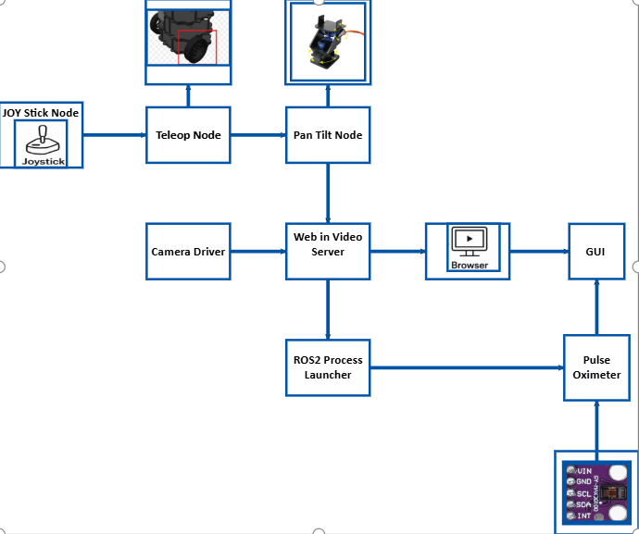
Integration

Slide 11
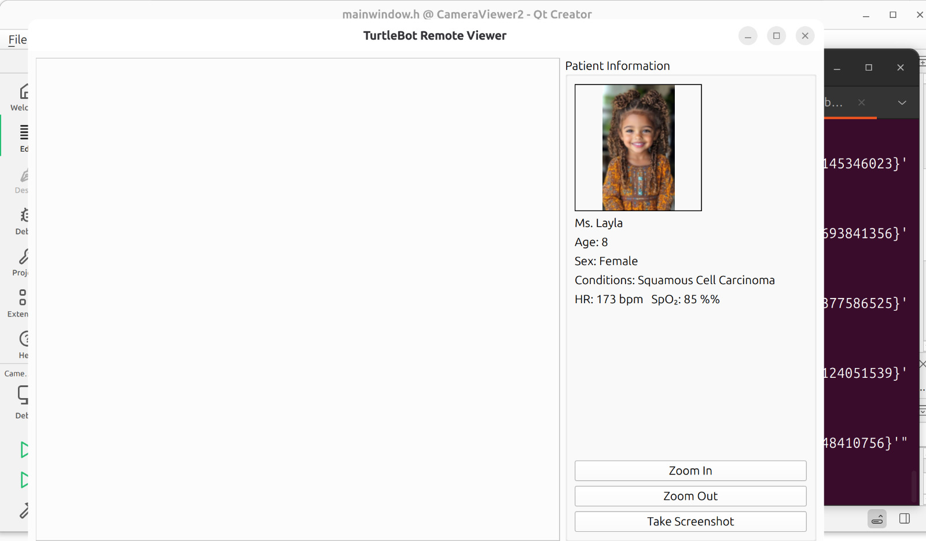
GUI Interface
Developed using Qt 6 (C++)
Displays:
Live camera stream
Patient personal data
Real-time vital signs (HR, SpO₂)
Includes:
Zoom control
Screenshot capture

Slide 12
Qt Files
qt_add_executable(CameraViewer2
main.cpp
mainwindow.cpp
mainwindow.h
mainwindow.ui
)
1) CMakeLists.txt
The project name
The C++ version
Which QT libraries are required
links all the source files together to generate the final executable.
2) Main.cpp
Creates the QT application
Opens the main window
Keeps the program running
int main(int argc, char *argv[])
{
QApplication a(argc, argv);
MainWindow w;
w.show();
return a.exec();
}

Slide 13
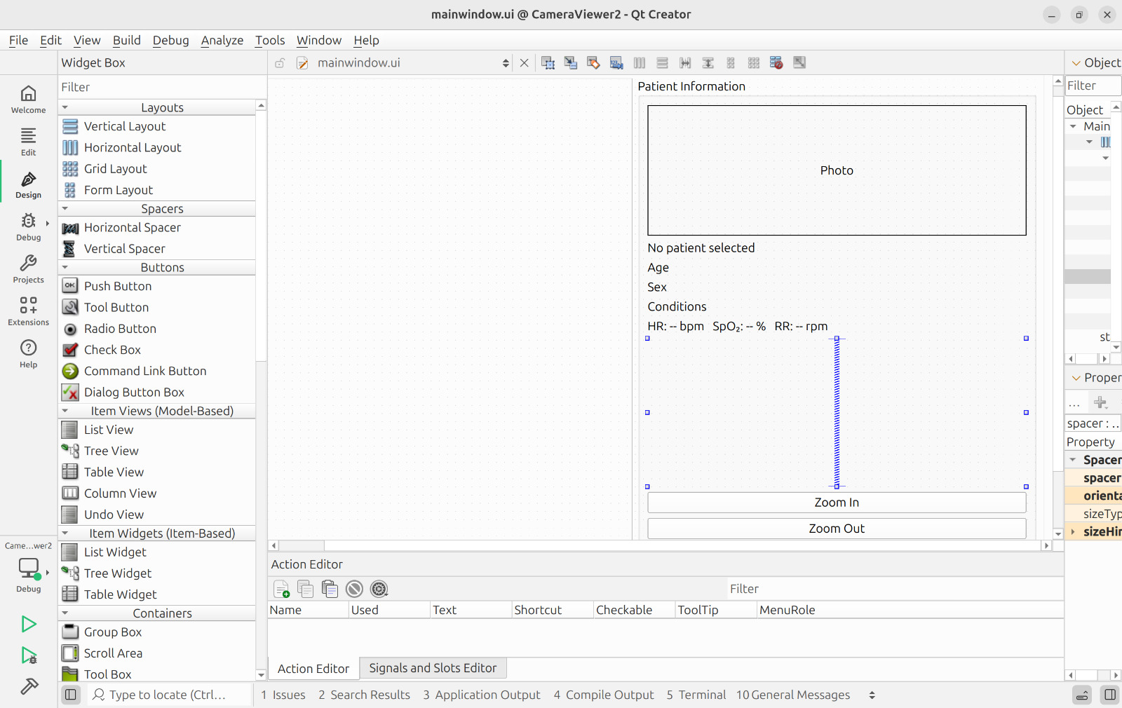
3) mainwindow.h
functions, classes, and variables
4) mainwindow.ui
Window size
Button locations
Labels
Layouts
It contains NO logic and NO C++ code
void setPatientInfo(const QString &name, const QString &photoPath);
void setPatientDetails(int age, const QString &sex, const QString &conditions);
void updateVitals(double hr, double spo2);

Slide 14
5) mainwindow.cpp
Runs the camera
Uses QT Network module
Receives MJPEG stream
Displays real-time video
Displays images
Updates patient info
Controls zoom
Saves screenshots
Updates vitals in real time
QUrl url("http://10.136.197.227:8080/stream?topic=/image_raw");
zoomFactor += 0.1;
updateDisplay();
shot.save(filename, "JPG");

Slide 15
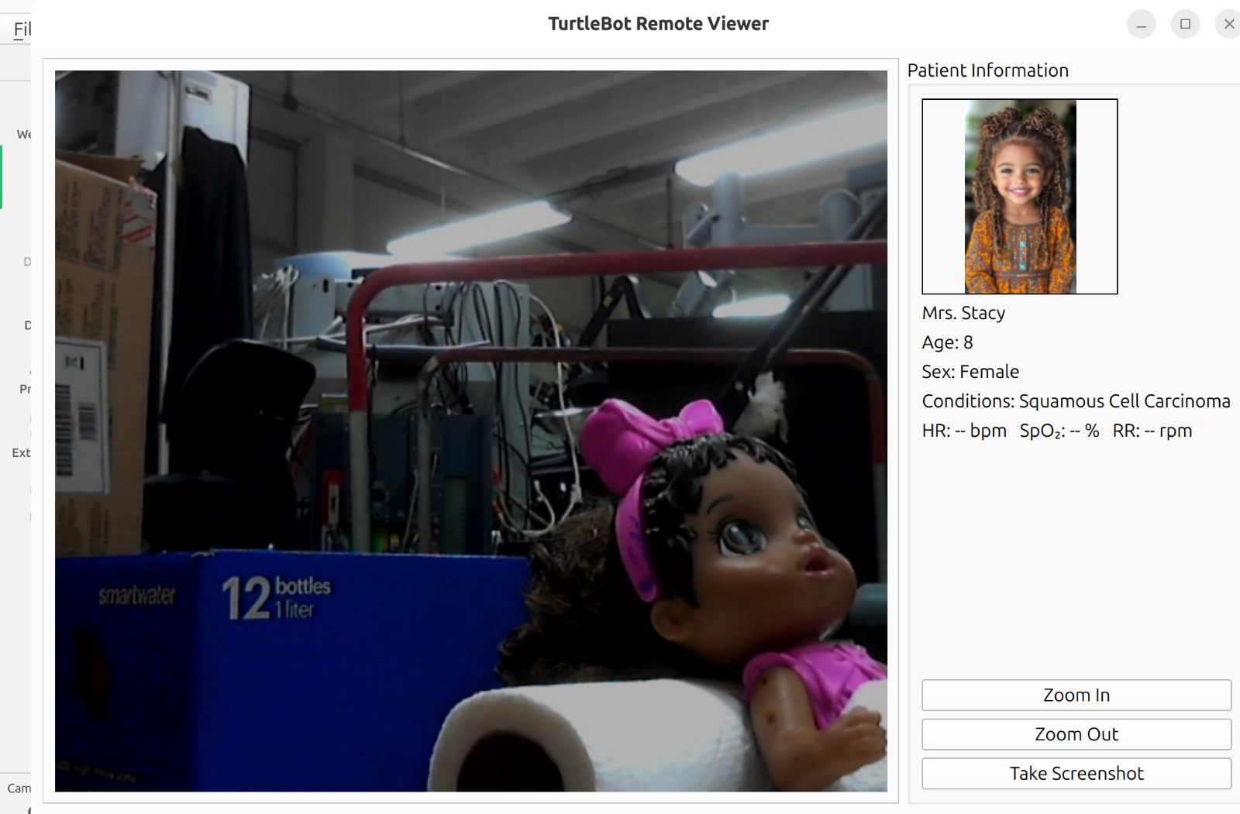
Results
Joystick control responsive
Pan-Tilt camera movement functional
Live video successfully displayed
Patient photo loads correctly
Patient data displayed properly
Real-time vital signs update correctly
Zoom feature works smoothly
Screenshot saved successfully

Slide 16
Validation& Performance Outcomes
✅ Nodes functioned correctly
✅ Stable communication with low latency
✅ Battery duration met operational expectations
✅ All subsystems worked together
✅ Accurate and consistent robot response
✅ Acceptable real-time performance

Slide 17
System Limitations
Joystick twist caused stamped motion
Pan-Tilt servo jittering
Camera mount does not fully represent robot motion direction
Pan-Tilt angles not perfectly centralized
Hygiene procedures for pulse oximeter still in progress

Slide 18
Future Work
Improve pan–tilt servo stability
Advanced safety features
Lower communication latency
Expand medical monitoring
Mobile / Web-based control interface
Automated hygiene system
Computer Vision Integration
SLAM & Mapping
Cloud Data Storage
Encrypted Medical Transmission

Slide 19
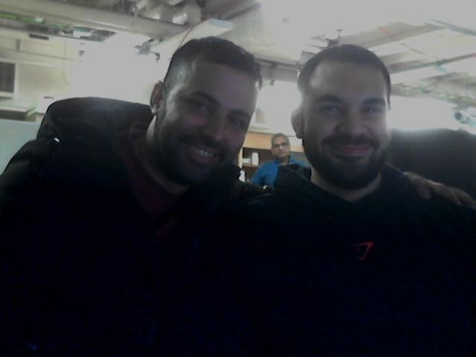
Thank you!
DEMO Time

